Slide 1

Analysis of Algorithms
ICS 340, Spring 2021

Slide 2
Based on Introduction to Algorithms Third Edition by
Cormen, Leiserson, Rivest & Stein
Chapter 3
Pictures and captions from text, notes from instructor

Slide 3
Asymptotic Analysis
We often want to figure out how long an algorithm runs as a function of the input size.
In previous courses, you should have done very simple, informal asymptotic analysis of algorithms.
public void hi( int n ) {
for ( int j = 0; j < n; j++ ) {
System.out.println( “Hello, world.” );
}
}
We are normally interested in the asymptotic behavior of algorithms
Most interesting problems are large enough that asymptotic behavior is important

Slide 4
Asymptotic Analysis
We usually analyze the worst-case behavior of algorithms
More tractable than the average-case analysis
Although in some cases, we use algorithms with a better average case complexity rather than one with a better worst case complexity.
Quicksort vs merge sort
We analyze algorithms more formally in this course.
Our programs may involve average-case analysis by experimentation or analysis.

Slide 5
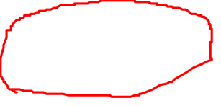
Upper Bounds (O)
O(g(n)) = { f(n) : there exists positive constants c, n₀ such that 0 ≤ f(n) ≤ cg(n) , for n ≥ n₀.}
Big-O is an upper bound.
If we know the bound is loose, we call it a little-o bound (o(f(n))).
o(g(n)) = { f(n) : for all positive constants c, there is an n₀ such that 0 ≤ f(n) < cg(n) , for n ≥ n₀ }.
That is,
Notes:
#1

Slide 6

Lower Bounds (Ω)
Ω(g(n)) = { f(n) : there exists positive constants c, n₀ such that 0 ≤ cg(n) ≤ f(n) , for n ≥ n₀.}
Big- Ω is a lower bound. It may or may not be tight.
ω(g(n)) = { f(n) : there exists positive constants c, n₀ such that 0 ≤ cg(n) < f(n) , for n ≥ n₀.
Little-ω is a loose lower bound.

Slide 7
Properties of Bounds
Note all the properties of bounds on pp. 51-52. These may come in handy.
Note that the trichotomy property doesn’t hold for asymptotic complexity.
f(n) need not be O(g(n)) or Ω(g(n)) for a given g(n).
f(n) = n^{1+sin n} is neither O(n) or Ω(n)

Slide 8
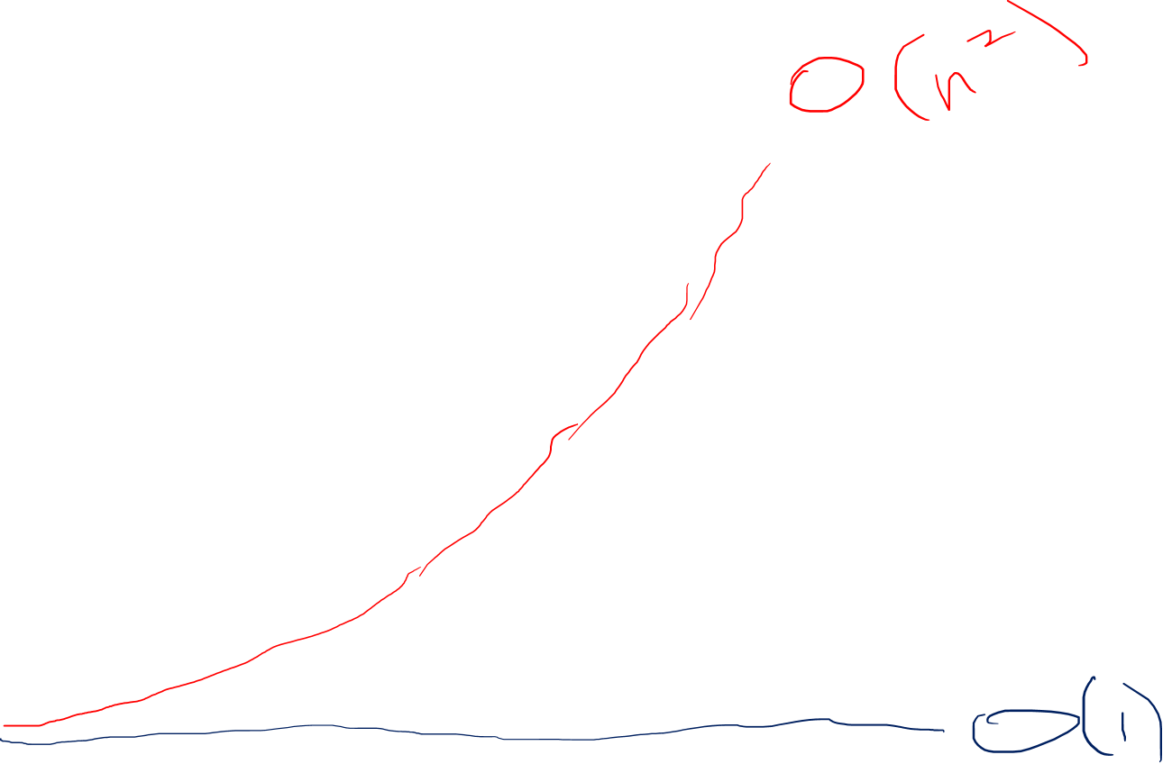
F(n) = n^(1+sin n)

Slide 9
Note on O(…) and Ω(…) bounds
For full credit on problems, you will need to get the best O(…) or Ω(…) bound.
So for full credit, the upper bound of the following method is O(n).
public void hi( int n ) {
for ( int j = 0; j < n; j++ ) {
System.out.println( “Hello, world.” );
}
}

Slide 10
Θ-notation: tight bound
Θ(g(n)) = { f(n) : there exists positive constants c₁, c₂, n₀ such that 0 ≤ c₁g(n) ≤ f(n) ≤ c₂g(n) , for n ≥ n₀.
Note that f(n) must be asymptotically nonnegative.
This is not usually a problem with computers!

Slide 11
Warning
Don’t confuse upper vs lower vs tight bounds with worst-case vs best-case vs average case complexity.
For instance, you could have a lower bound to the worst-case complexity or an upper bound to the best-case complexity.

Slide 12
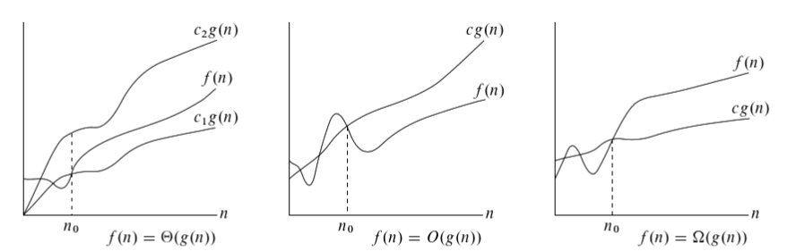

Θ, O, and Ω bounds in pictures
Copyright © The McGraw-Hill Companies, Inc. Permission required for reproduction or display.
Notes:
#2

Slide 13
Example
Let’s show that f(n) = n²+1 is O(n²).
That means we find values c > 0 and n₀ > 0 such that f(n) ≤ cn² for all n ≥ n₀.
An easy way to do this is to guess a value for one parameter and then figure out what value works for the other parameter. For instance, take c = 2. Then find a value of n₀ such that n²+1 ≤ 2n² for all n > n₀.
Doing the algebra, this is true whenever n² ≥ 1. So we could choose n₀ = 1, say, and then f(n) ≤ 2n² for all n ≥ 1. So f(n) = O(n²)
We don’t even try to pick the exactly minimal values for c and n₀. It doesn’t matter.

Slide 14
Transitivity and Transposition
Some common results, should be clear wo/proof.
f(n) = Θ(g(n)) && g(n) = Θ(h(n)) ⇒ f(n) = Θ(h(n))
f(n) = O(g(n)) && g(n) = O(h(n)) ⇒ f(n) = O(h(n))
f(n) = Ω(g(n)) && g(n) = Ω(h(n)) ⇒ f(n) = Ω(h(n))
f(n) = O(g(n)) ⇔ g(n) = Ω(f(n))

Slide 15
Common functions
Discussed in text
I don’t expect you to memorize these
But be able to reference these and use them
Some are more important than others.
Notes:
#3

Slide 16
Common functions I
Monotonicity
Usually, this is a good assumption.
Generally, the bigger the problem, the longer it takes.
Floors and ceilings
For asymptotic complexity, we can ignore these
However, these are related to the question of the boundary conditions of loop control variables.
They’ll come up in some cases when dealing with logarithms.

Slide 17
Common functions II
Modular Arithmetic
Vital in hashing computations, which we assume you know but which we may use.
Also vital in cryptography, which is beyond the scope of this course.
Polynomials
Having passed algebra (and probably pre-calculus and calculus), you should be able to work with these fluently.
Factorials
Stirling’s approximation:
Might come in handy.

Slide 18
Common functions III
Logarithms
A lot of you are probably rusty on logarithms
We use them a lot in this class
Note that logs to different bases differ by only a constant factor
So we can talk about O(log n) and not care about the base.
“lg n” means “log₂ n”, and we generally use base-2 logs.
One time we may use the natural logarithm ln n.

Slide 19
Common functions III
Properties to remember or be able to look up:
log_{c}(ab) = log_{c}a + log_{c}b
Log_{b} a^{n} = n log_{b}a
.
.

Slide 20
Common functions IV
Exponentials
The inverse of logarithms.
Much of algorithms is about finding ways to speed up or deal with exponential time algorithms.

Slide 21
Very Broad Rates of Growth
For all a, b, c, with a > 1, b, c > 0:
So n^{b} = o(a^{n}) and lg^{b}n = o(nª)
The first one is easy to see if you remember L’Hopital’s rule.
If lim (f(n)/g(n)) “=“ ∞/ ∞, lim (f(n)/g(n)) = lim (f’(n)/g’(n))
F(n) = n^{b}, f’(n) = bn^{b-1}, f’’(n) = b(b-1)n^{b-2}, etc.
G(n) = a^{n}, g’(n) = a^{n} ln a, g’’(n) = a^{n} ln²a, etc.
Successive derivatives of f become constant
Successive derivatives of g are a^{n} times a constant

Slide 22
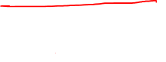
Very Broad Rates of Growth
All exponentials grow faster than all polynomials.
In fact, polynomial time algorithms are considered “tractable” (you can run them on large problems)
and exponential time algorithms are “intractable” (you need to find a polynomial time approximation to them for large problems).
All polynomials grow faster than all logarithms.

